Slide 1
LE 1360-005 OPENING DIVERSE DOORS
BY: KA LAI CHAN
FINAL PROJECT:
GREAT HISTORICAL INDIVIDUAL

Slide 2
Christina Wong, Ming Yan
Writing in the Dark

Slide 3
Biography
First visually impaired writer and music artist in Hong Kong
Contracted German measles when she was only 8 months old.
Her optic nerves were infected → became blind → 6 epikeratophakia operations (ages 3--8) → optical nerves were injured → become blind
An optimistic person

Slide 4
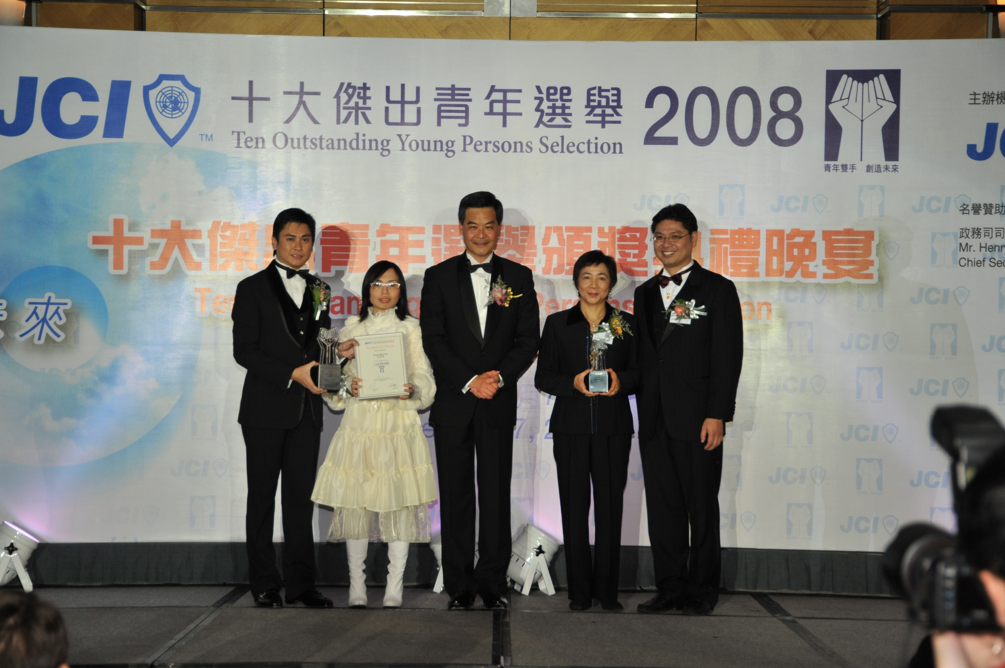
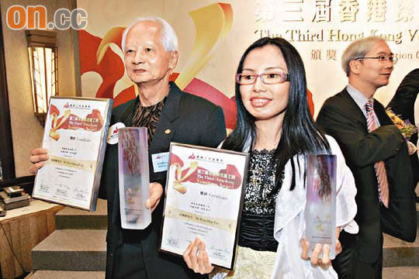
Her Success…
Awards:
The Ten Outstanding Young Persons in 2008
The Hong Kong Volunteer Award in 2009
Bauhaus TOUGH 15 Award in 2009

Slide 5
Her Success…
Books:
4 books:
If You Believe in Fairy Tales
The Girl Steps towards the Rainbow
LOVE is what we treasure
Seven Stories

Slide 6
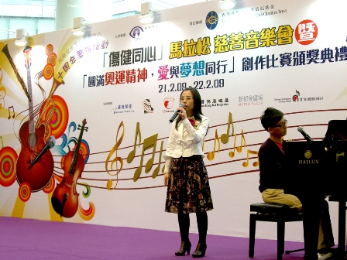
Her Success…
Songs:
"Hope for Peace”
"Brother”
"Heart Song in Silent Night".

Slide 7
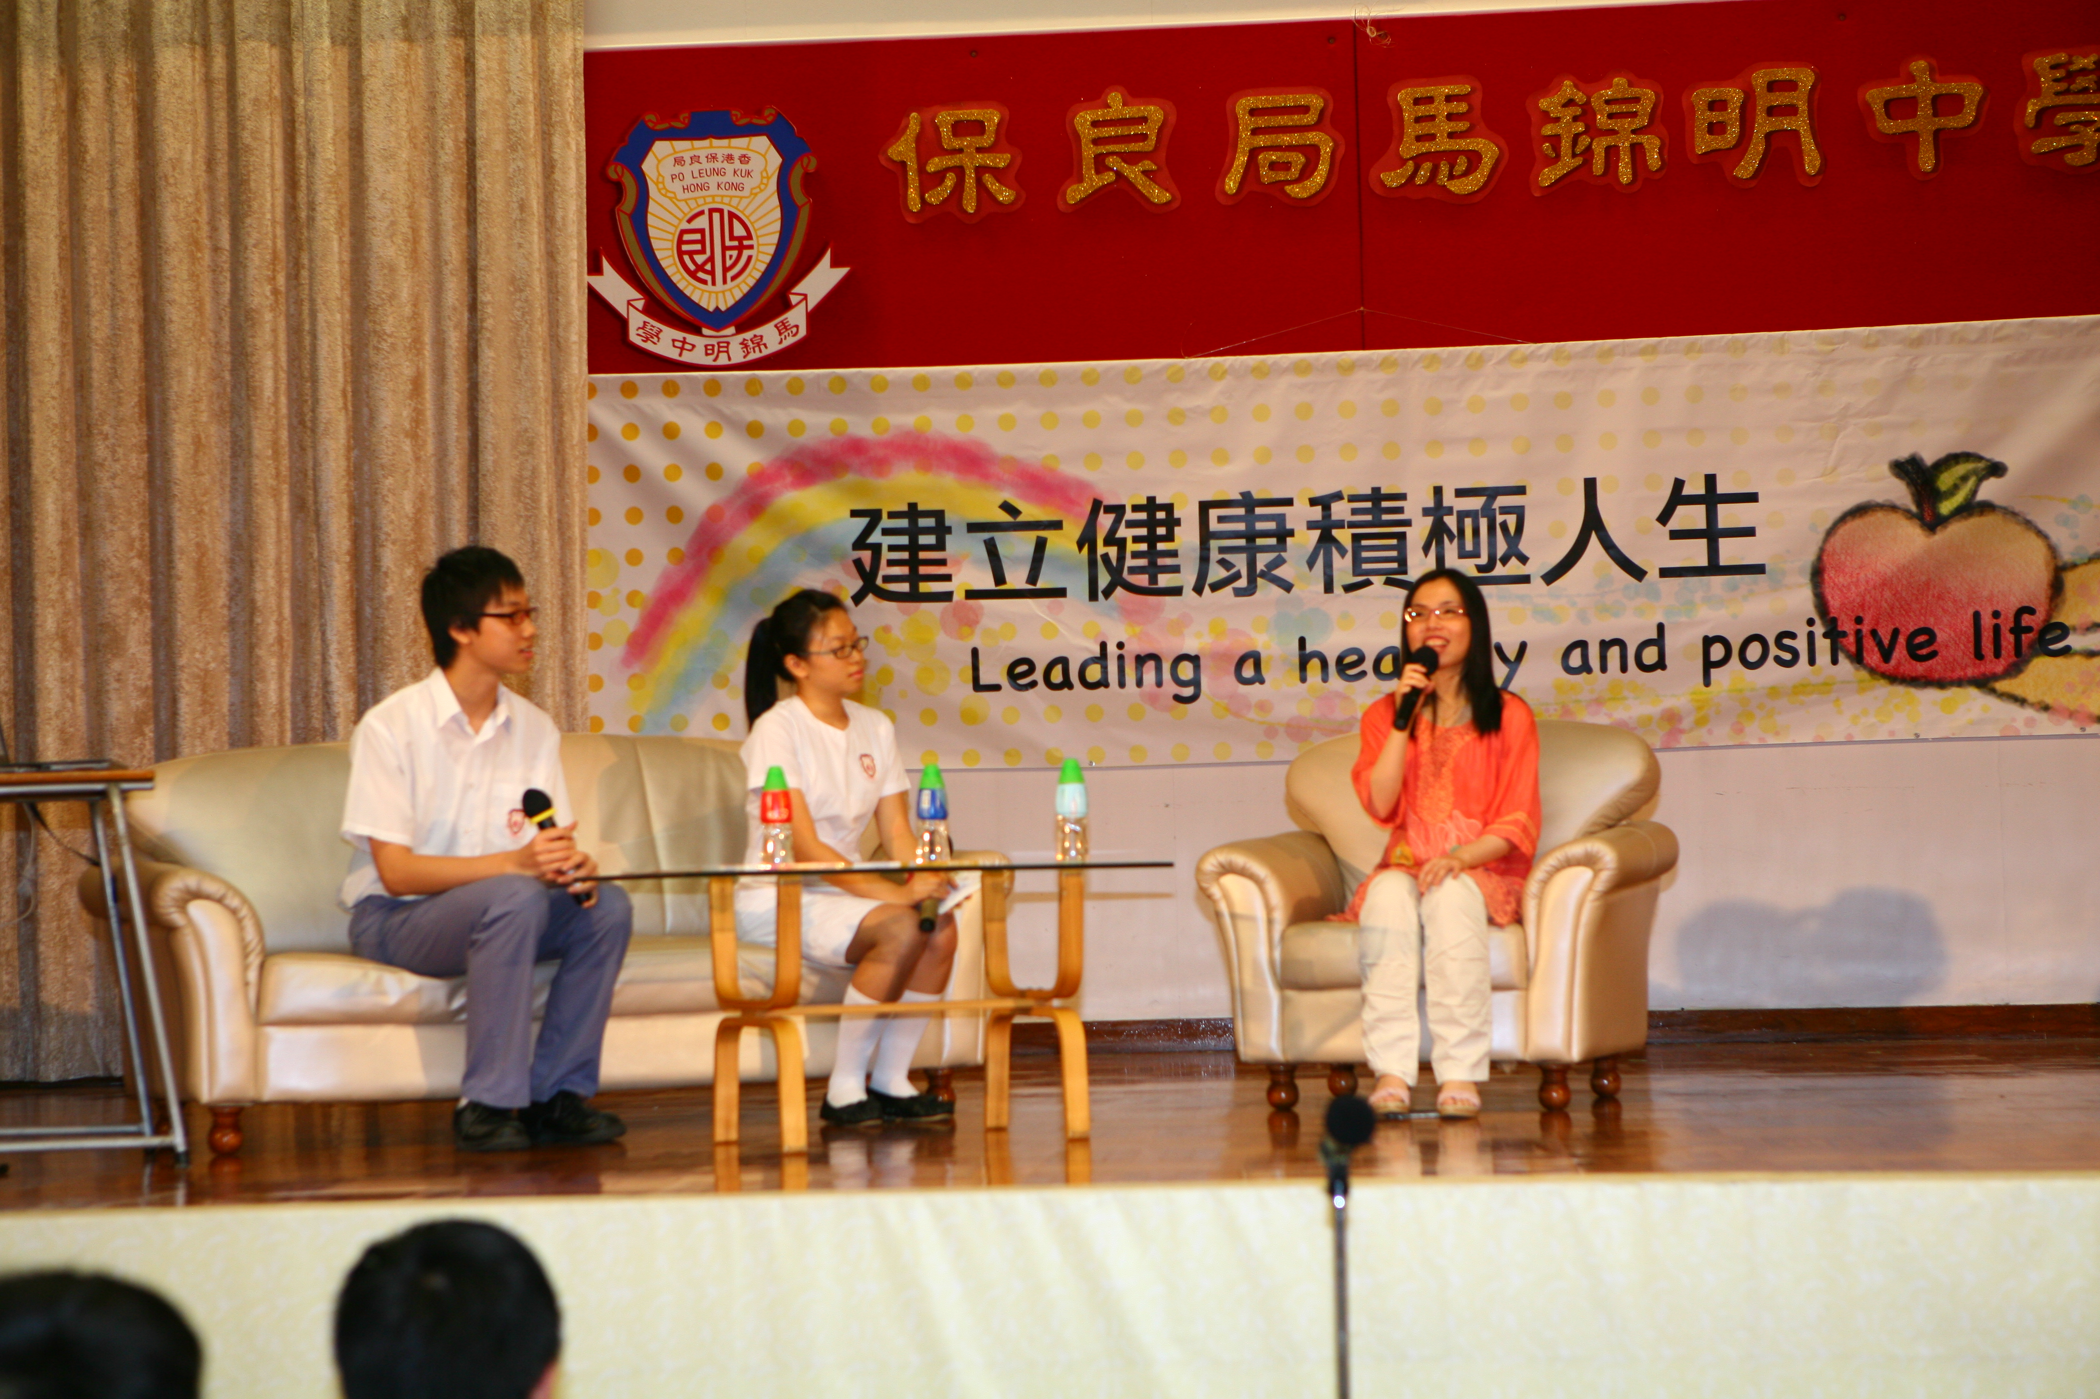
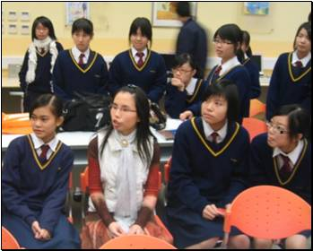
What she is doing…
Writing and creating more meaningful and beautiful creations. → Books, Songs, Paintings…
Volunteer work → Visiting primary and secondary schools → To promote the positive living attitude by sharing her life experience
Promotion of art and education → Performing shows and concerts （representing Hong Kong for various events） → Being a judge at different shows and competitions

Slide 8
Why I choose her …
To overcome difficulties positively → Everyone has his/her hardship → →No one is perfect → the strengths and the weak
Never give up !!

Slide 9
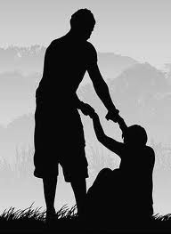
Why I choose her … (Continue)
Optimistic →preservative →optimistic →enthusiastic
Change a life by a life →a person ~ limited →cooperation ~ powerful
A successful lady

Slide 10
Source…
http://zh.wikipedia.org/zh-hk/%E6%B1%AA%E6%98%8E%E6%AC%A3
http://www.wataboshi.net/artists/detail.php?place=&artist_id=0010
http://www.hksb.org.hk/en/index.php?option=com_content&view=article&id=98&Itemid=6
http://www.plkmkmc.edu.hk/plk_photos.asp?GroupID=127&yid=
http://www.hkpo.com/tch/concerts_and_ticket/artists/artistsdetail.jsp?id=1097
http://hk.knowledge.yahoo.com/question/question?qid=7007101103397
http://finance.qq.com/a/20111209/006290.htm

Slide 11
Questions?

Slide 12
Wish all of you have a Successful and Wonderful future!
Go for your DREAMS!

